Slide 1
Developing an Information Management Code Repository
Kristin Vanderbilt
Colin Smith
Environmental Data Initiative

Slide 2
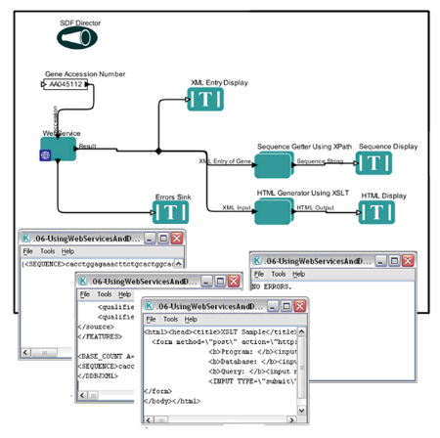
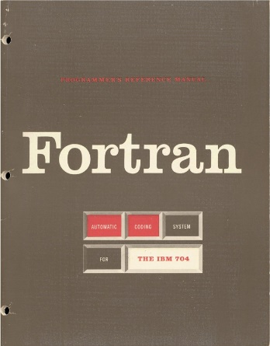



What is the IM code repository?
A community space where participants contribute code and discover code to re-use
For Information Managers, scientists, students, others
Limited to code for IM tasks
Language agnostic

Slide 3

Our goal today…
…is to create a blueprint for how the IM code repository will operate

Slide 4

Considerations:
Repository
Structure
Governance
Code
Reusability
Discoverability

Slide 5
How should the IM Code Repository be structured?
Decentralized approach – the repository is essentially a catalog, pointing to whatever repository the code developer prefers
Centralized approach – all code is in github
Hybrid approach – a catalog plus the centralized repository

Slide 6

How should the code repository be governed?
A committee:
Specialists in different programming languages.
Responsible for ensuring that code passes quality tests and for evaluating metadata for quality and completeness.
Distributed workload.
Issues:
Number of members
Term of service and rotation
Credit for service

Slide 7

What are the minimum requirements that a script should meet?
Generalized, not project specific
Well documented at the code package level and within the source code
CodeMeta minimal metadata schema for science software and code
Documentation of how code is installed and used
Controlled vocabulary terms
Code is thoroughly commented and adheres to a language-specific style guide
Pass conceptual tests and tests of the code itself
Example data sets and expected output (use cases)
Provides meaningful error messages

Slide 8
Code Discoverability
Controlled vocabulary
Application to query metadata

Slide 9


Other considerations
Incentives to contribute to repository
Maintenance/updates of code
User Support
Licensing

Slide 10

Join us to finish the IM Repository blueprint!
Volunteers sought to co-author and review the ‘blueprint’

